Slide 1

Identify common queries and create appropriate indexes for the VeaCy database.

Slide 2
INDEX
Indexing makes columns faster to query by creating pointers to where data is stored within a database.
An index is a structure that holds the field the index is sorting and a pointer from each record to their corresponding record in the original table where the data is actually stored.
Indexes are used in things like a contact list where the data may be physically stored in the order you add people’s contact information but it is easier to find people when listed out in alphabetical order.
Creating an index on a field in a table creates another data structure which holds the field value, and a pointer to the record it relates to.

Slide 3
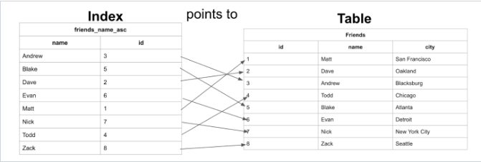
Example: We can see here that the table has the data stored ordered by an incrementing id based on the order in which the data was added. And the Index has the names stored in alphabetical order.

Slide 4
Index for Common Queries in VeaCy database
In VeaCy database, the User table stores the details of Admin, Investment Manager, Investor, Investor_Invitee, Nominee in a single table.
For this scenario, Indexing is used for grouping the Users by their roles and creating separate index for them using “GROUP BY”.
Indexing can also be used in finding the status of a user who completed, by grouping them using their status along with their names in database using “WHERE”.
It is also used in Investor table which is very large to retrieve data.

